Slide 1
Optiver Realized Volatility Prediction
Chensheng Ma, Deyu Li, Zeyang Zhou

Slide 2
Agenda
1.Background and recap
2.Intro
3.feature engineering
4.model selection and comparison
5.evaluation

Slide 3
Background and Recap
In financial markets, volatility captures the amount of fluctuation in prices. High volatility is associated to periods of market turbulence and to large price swings, while low volatility describes more calm and quiet markets. For trading firms like Optiver, accurately predicting volatility is essential for the trading of options, whose price is directly related to the volatility of the underlying product.
Building models that predict volatility and continuously generate fairer options prices for end investors.
We got data set contains order book snapshots and executed transactions for the first 10 minutes associated with more than 100 stocks.

Slide 4
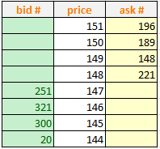
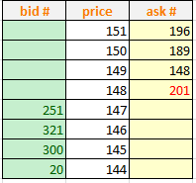
Intro - book and trade table
Order book of stock A
Trade book of stock A
You want to buy 20 shares of a stock A

Slide 5
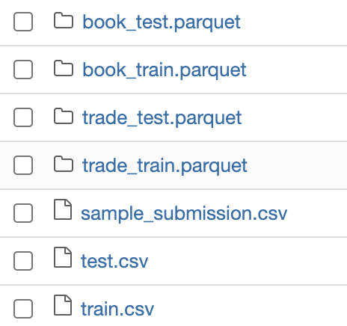

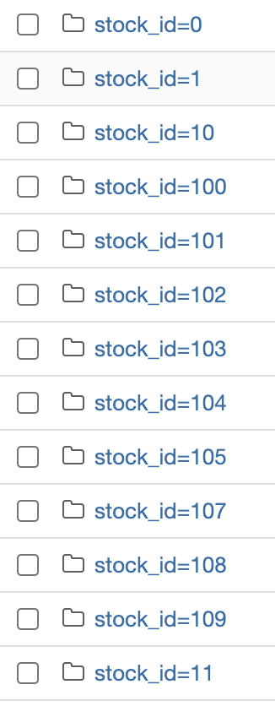
Intro - Dataset
… total 112 stocks within train datasets

Slide 6
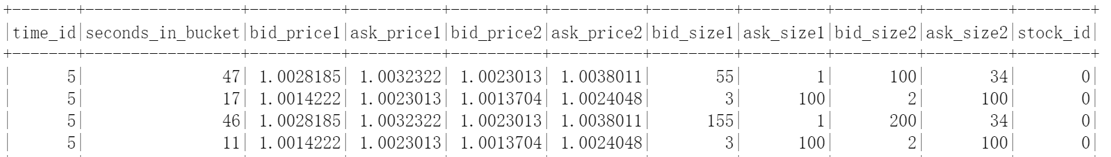
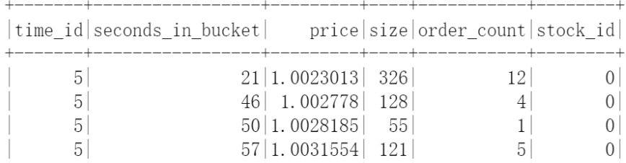
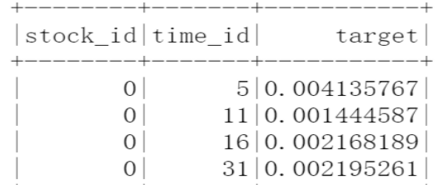
Intro - Dataset
Order book
Trade book
Train.csv - ground truth

Slide 7
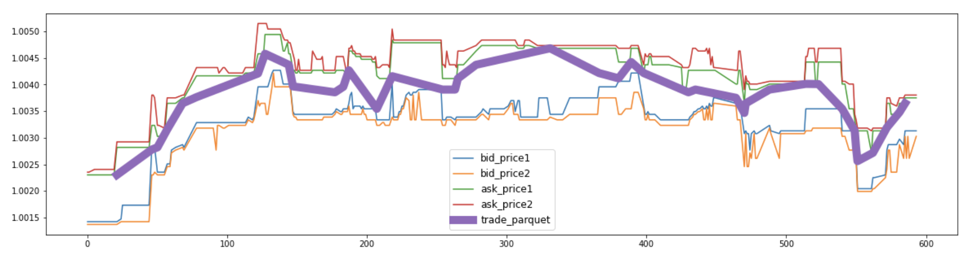
Intro - visualization
This chart only takes prices into account and regardless of the size(amount), we could see that ask prices is always higher than bid prices, and the actuarial transaction is always between them.
There is defense and offense between sellers and buyers.
Stockid = 0
Timeid = 5

Slide 8
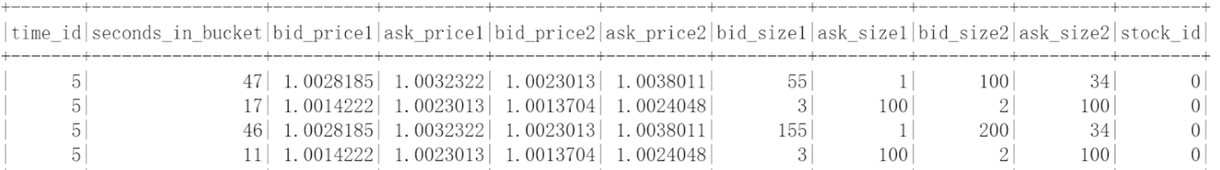
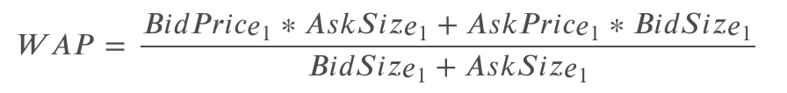
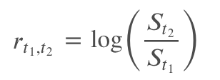
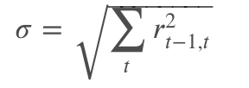
Intro - statistics
Weighted averaged price
A fair book-based valuation must take two factors into account: the level and the size of orders. In this competition we used weighted averaged price, or WAP, to calculate the instantaneous stock valuation and calculate realized volatility as our target.
(Book table)
Log return
Returns are widely used in finance, however log returns are preferred whenever some mathematical modelling is required. Calling
𝑆𝑡,St is the price of the stock S at time 𝑡, we can define the log return between t1 and t2 as
Realized volatility
We will compute the log returns over all consecutive book updates and we define the realized volatility 𝜎

Slide 9
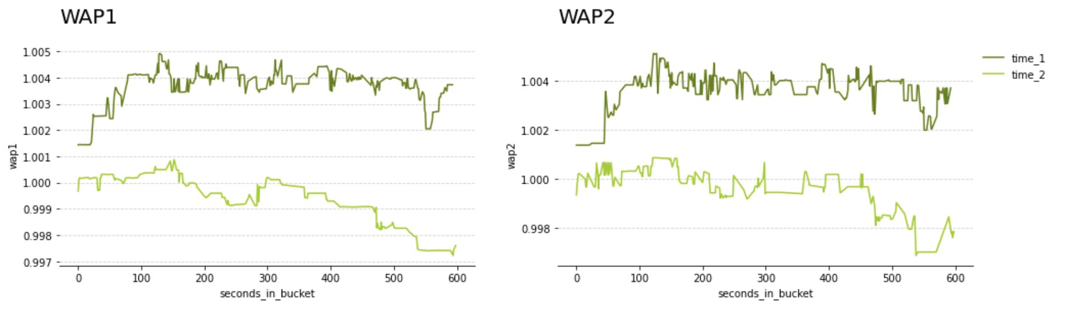
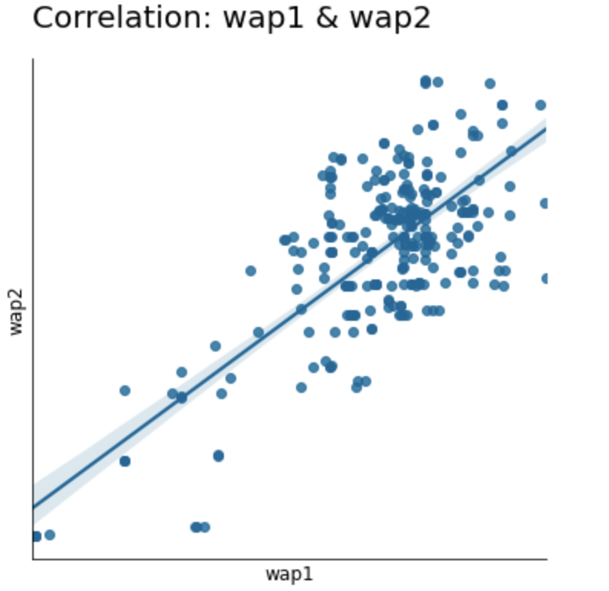
Intro - visualization
Compare weighted average price 1 and 2 with same stock_id and different time_id:
stock_id=0
time_1 : timeid=5
time_2 : timeid=16
Correlation between weighted average price 1 and 2

Slide 10
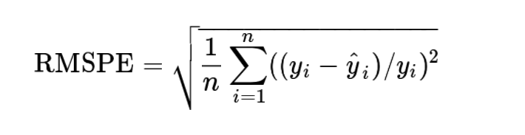
Intro - evaluation metric
Submissions are evaluated using the root mean square percentage error, defined as:
Realized volatility
Predicted Realized volatility

Slide 11



Feature engineering
Since the feature we have is limited, so according to some fundamental mathematical functions we create some new features:
Multiple bid price 1/2 and ask price 1/2 intersectly:
bid_price1 * ask_price1 ; bid_price2 * ask_price2 ; bid_price1 * ask_price2 ; bid_price2 * ask_price1
Adjust given WAP formula:

Slide 12
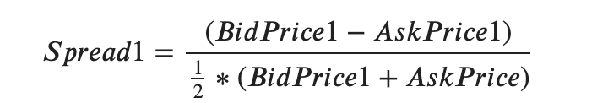
More Features we added
More created features in our range:
Price Spread features:
Price Volume:
Volume Imbalance:
K-means and different scientific mathematics features based on financial and market background.
Notes:
price_spread: the difference between ask price and bid price. Wide spread means low liquidity, leading to high volatility.
volume: the sum of the ask/bid size. Low volume means low liquidity, leading to high volatility
volume_imbalance: the difference between ask size and bid size. Large imbalance means low liquidity for one side, leading to high volatility

Slide 13
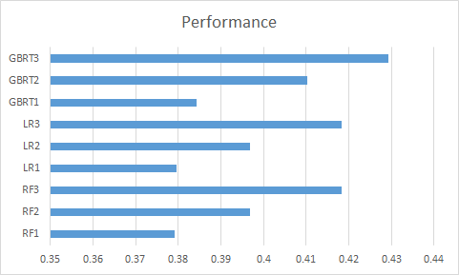
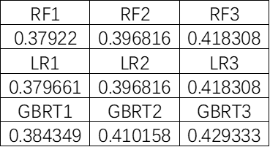
Feature engineering performance

Slide 14
Model selection
Linear Regression (Stepwise)
GBRT (Regression)
Random Forest (Regression)

Slide 15
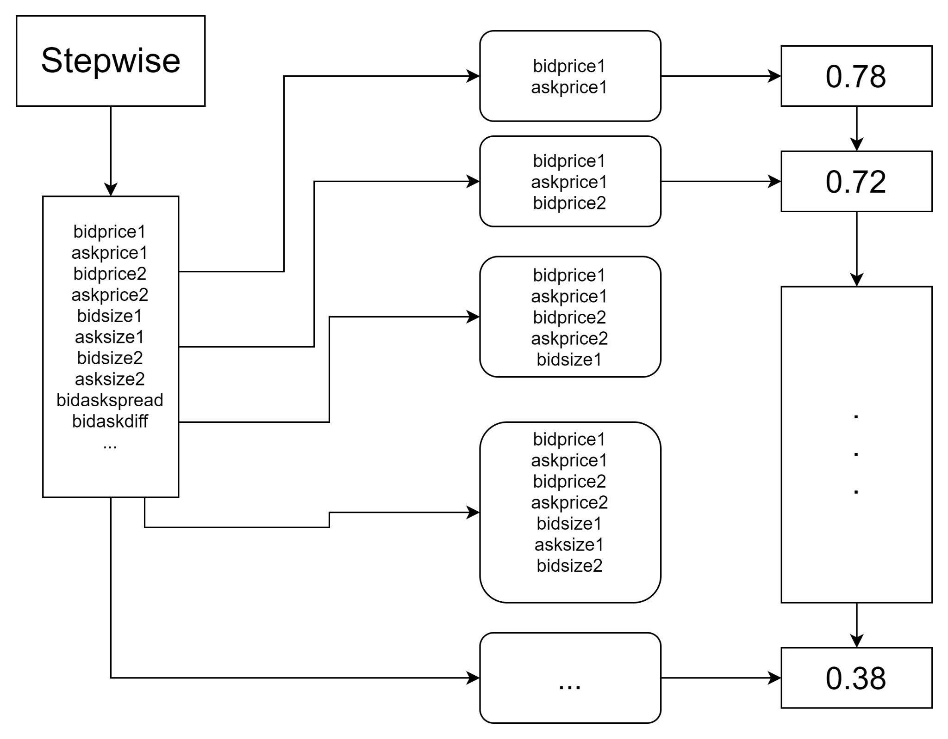
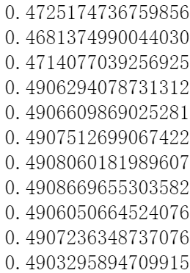
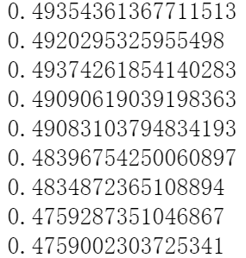
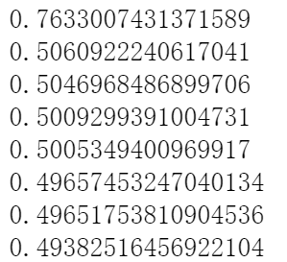
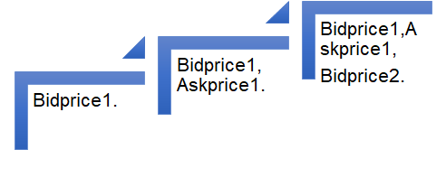
Linear Model

Slide 16
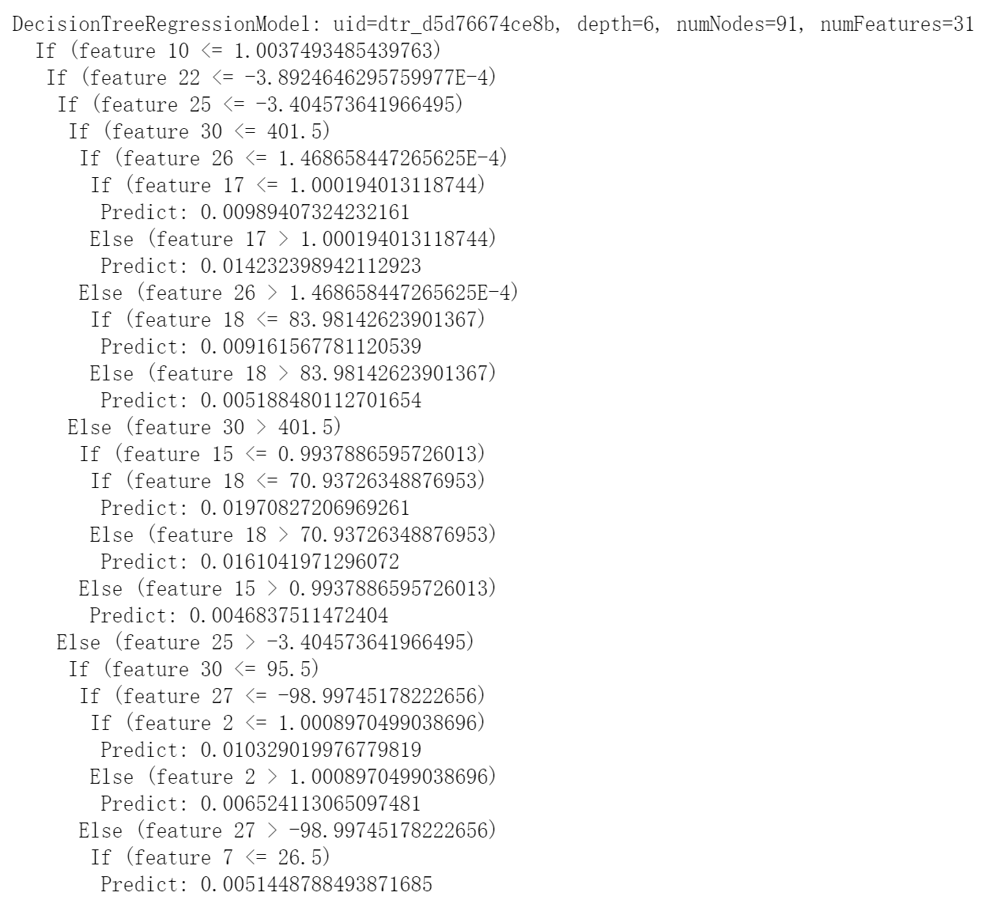
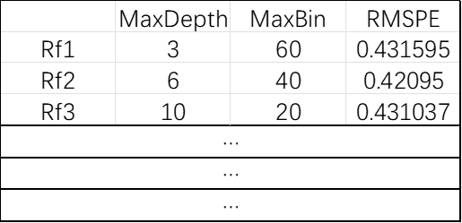
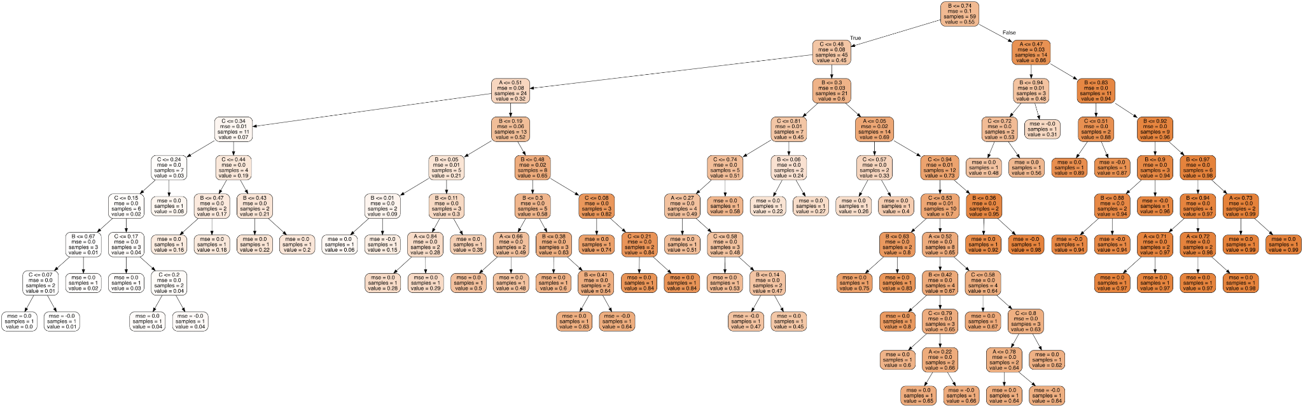
Random Forest & GBRT
Example Tree

Slide 17
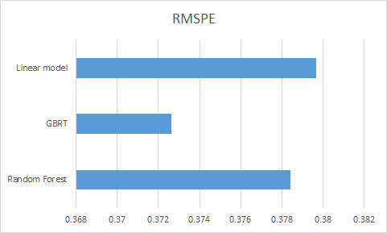
Result
The smaller RMSEP means closer the volatility to reality and better performance of the prediction. Based on the result, we could conclude that :
Rank:
GBRT > RF > LR
GBRT IS THE CHAMPION!!!

Slide 18
Thanks for watching

Slide 19
References
LightGBM starter with feature engineering idea. (n.d.). Retrieved December 6, 2021, from https://kaggle.com/tommy1028/lightgbm-starter-with-feature-engineering-idea
Lgbm baseline. (n.d.). Retrieved December 6, 2021, from https://kaggle.com/alexioslyon/lgbm-baseline
Optiver Realized Volatility Prediction. (n.d.). Retrieved December 6, 2021, from https://kaggle.com/c/optiver-realized-volatility-prediction
Optiver Realized: EDA for starter(English version). (n.d.). Retrieved December 6, 2021, from https://kaggle.com/chumajin/optiver-realized-eda-for-starter-english-version
Realised Vol—Weighted Regression Baseline. (n.d.). Retrieved December 6, 2021, from https://kaggle.com/lucasmorin/realised-vol-weighted-regression-baseline
Singh, J. (2020, December 26). Random Forest: Pros and Cons. Medium. https://medium.datadriveninvestor.com/random-forest-pros-and-cons-c1c42fb64f04

